Slide 1

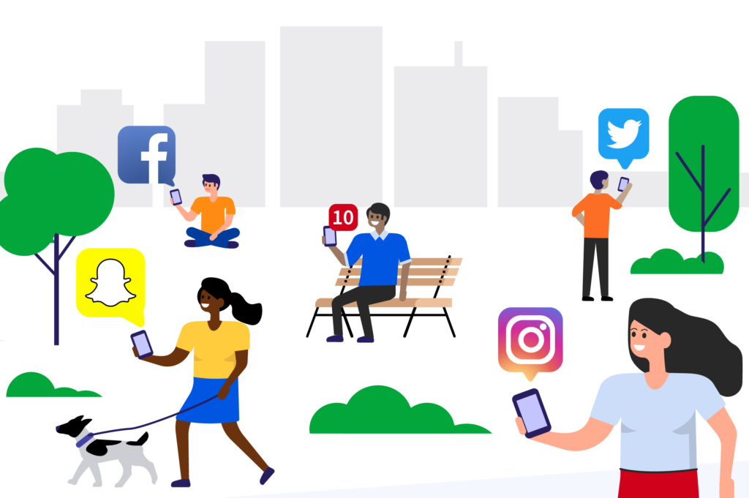
How does social media impact our lives?
Team members:
Anna Wrobel
Latyr Thiao
Lujane Abdelgadir
Prajakta Galvankar
Stephen Zhang

Slide 2
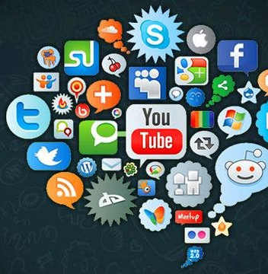
Thanks for your attention !
Table of contents
Motivations & Summary
Process summary
Data Cleanup & Exploration
Data Analysis
Questions & Findings
Conclusions & Limitations
Q & A

Slide 3
Motivation & Summary

Slide 4
Motivation & Summary
x
Main question:
How does social media impact our lives?
Motivation:
Social media is becoming increasingly important in our everyday lives
The number of users across all social media platforms is growing
We wanted to understand how much does it actually affect society
Key questions to explore:
Which social media platform/s do you like the most or use the most?
How much time is spent on social media vs physical activities?
Have you ever been a victim of cyber crime?
What type of communication is preferred?
Sources of information:
Data World Survey
https://data.world/maheepmahat/data-of-usage-of-social-media-by-students-between-age-17-22

Slide 5
Process summary

Slide 6
Process summary
x

Slide 7
Data Cleanup & Exploration

Slide 8
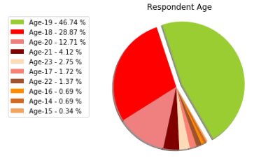
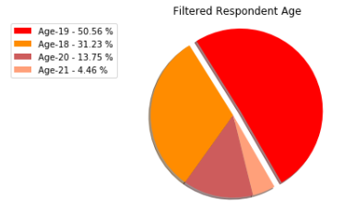
Data Cleanup & Exploration
We have applied a number of methods to clean up and organize the data
Filtered the data to focus on responses of 18 to 21 year olds ( > 4% ) in order to have a more meaningful profile of respondents:

Slide 9
Data Cleanup & Exploration
We have applied a number of methods to clean up and organize the data
Removed unnecessary columns in order to declutter the data and make it easier to read:
Removed timestamp
Removed empty columns
Looked for and removed unavailable/empty responses
Cleaned responses and streamlined iterations into one value:
One of the responses to types of cyber crime experienced was “Fake profile, none of the above”
Changed to “Fake profile”
Split the responses in order to count/tally the values:
For the responses that allowed for multiple answers, we split the answers using “comma separator” and tallied the results, this was applied for answers to:
Preferred social media
Preferred form of communication
Types of cyber crime experienced

Slide 10
Data Analysis

Slide 11
Data Analysis
We have applied a number of methods to analyse the responses
Analyzing the responses
Count / tally the responses for each question
For example: which social media platform is preferred by the respondents?
Groupby responses in order to understand the dynamic relationships
For example: relationship between platform preferences and time spent on social media
Visualising the findings
Pie charts
Bar charts
Stacked bar chart
Line regression

Slide 12
Questions & Findings

Slide 13
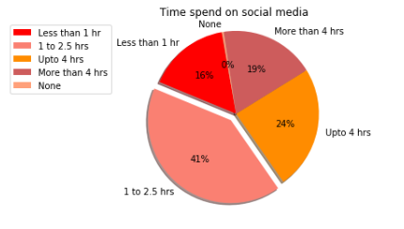
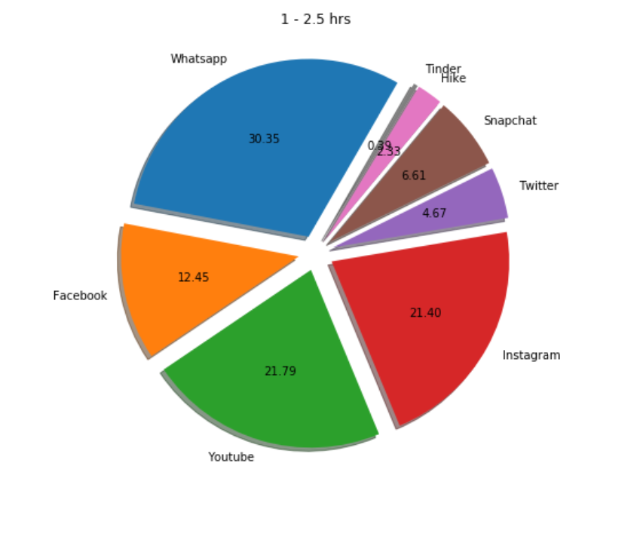
Which social media platform/s do you prefer and how often do you use social media?
41% of respondents use social media for 1-2.5 hours per day
WhatsApp, YouTube and Instagram are the most used social media platforms

Slide 14
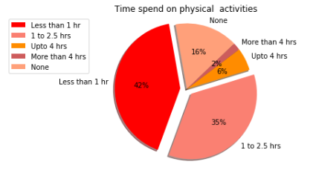
How much time is spent on social media vs physical activities?
41% of respondents spend less than 1 hour per day on physical activities
Majority of respondents spend more time on social media vs. physical activities

Slide 15
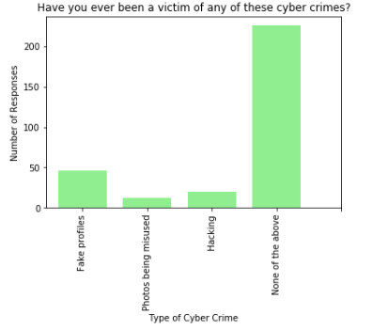
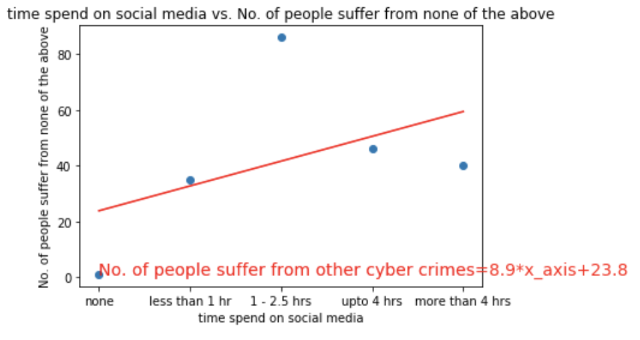
Have you ever been a victim of cyber crime?
Majority of respondents have not experienced the listed types of cyber crimes
The correlation between time spent online and exposure to cyber crime is insignificant due to large p value
However, with r-squared value between 0.3 and 0.5, we can also conclude weak correlation !

Slide 16
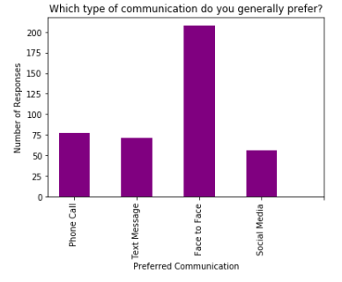
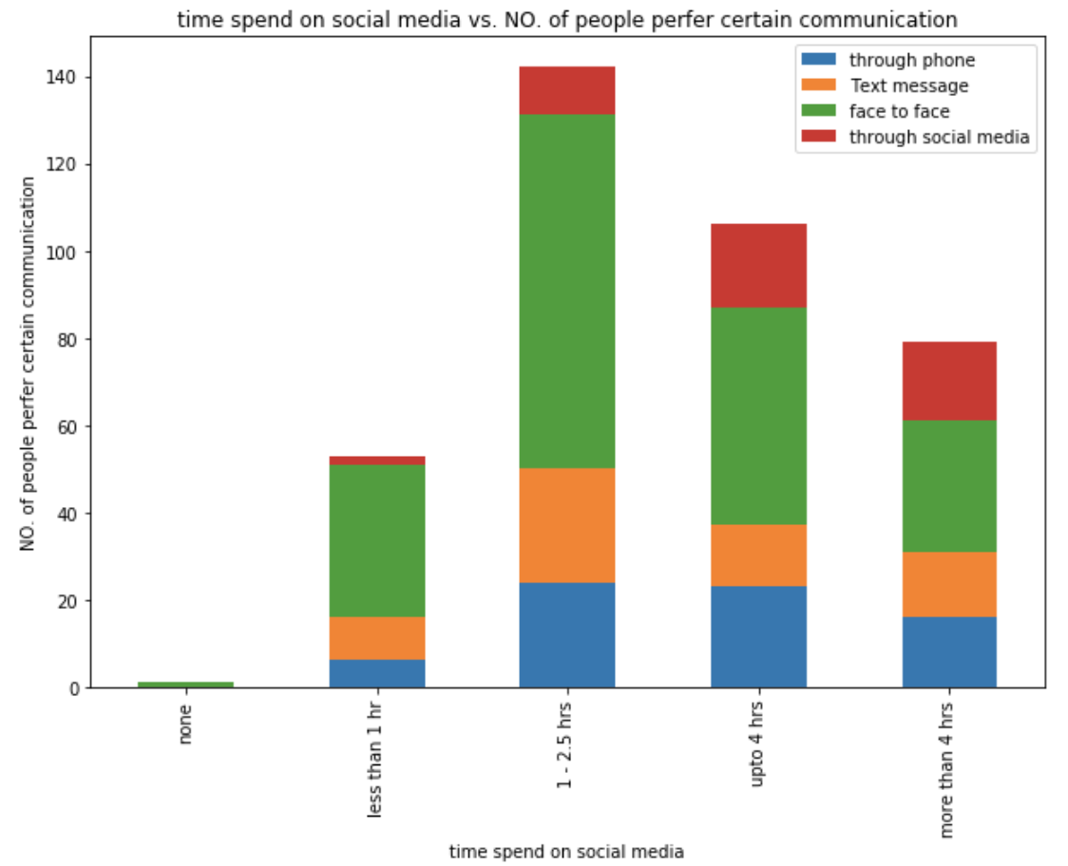
What type of communication is preferred?
Despite the increasing amount of time spent on social media, majority of respondents still prefer face to face communication

Slide 17
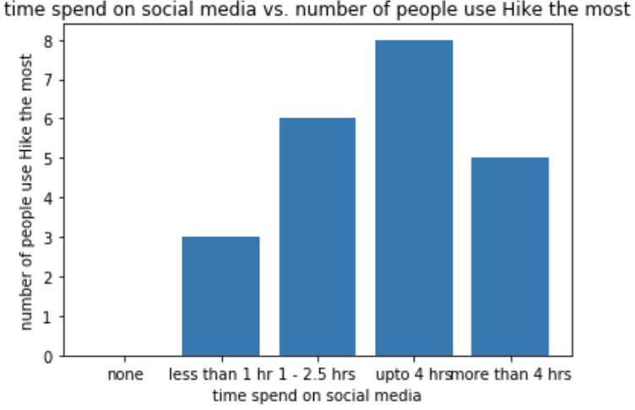
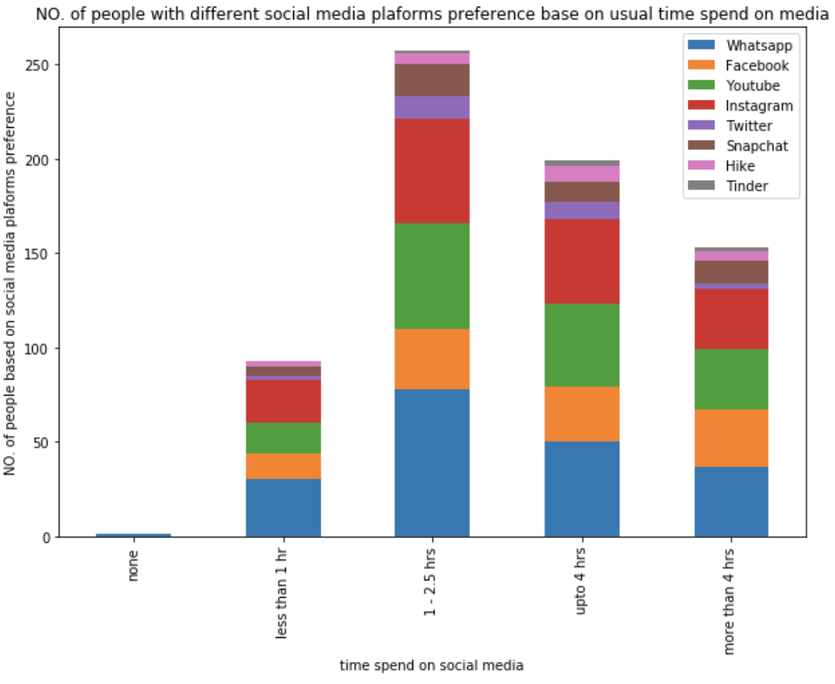
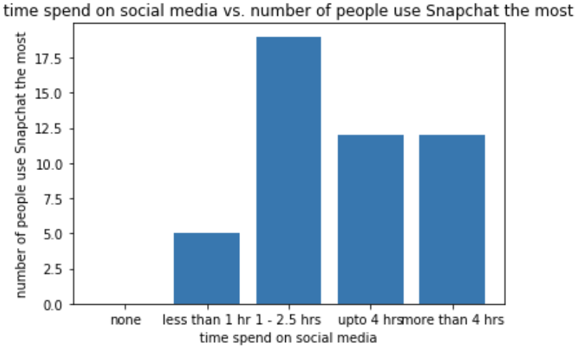
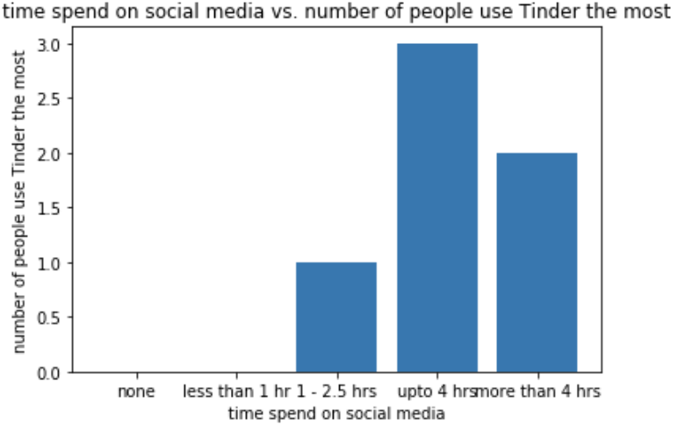
Is platform used impacted by time spent on social media?
Snapchat , Tinder and Hike as complementary social media platforms where people spend additional time on

Slide 18
Conclusions & Limitations

Slide 19
Conclusions & Limitations
Conclusions
Limitations & further research
How does social media impact our lives?
Which social media platform/s do you like the most or use the most?
How much time is spent on social media vs physical activities?
Have you ever been a victim of cyber crime?
What type of communication is preferred?
People tend to underestimate the time they spend online.
The study did not cover exposure to scams, bullying, fake news..etc.
The study did not identify the geographical location of respondents
The study did not include significant responses from other age groups
Physical activity was vaguely defined in the survey
Based on the dataset, people are using social media as an additional form of communication however it is not replacing the importance of face to face interaction.

Slide 20
Thank you! Q & A

